Slide 1
CABLING LAB

Slide 2
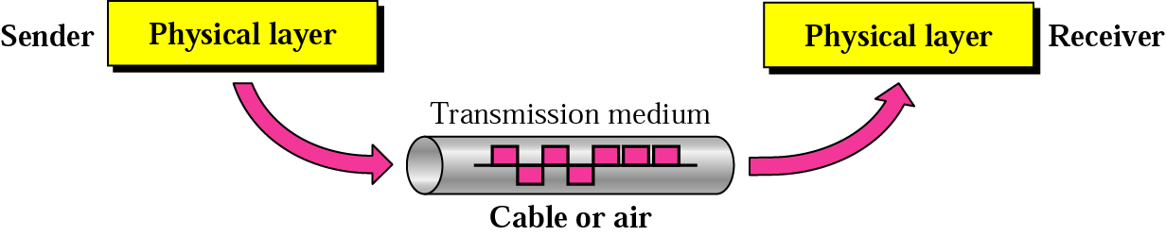
Physical Media
Physical Media

Slide 3
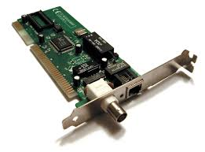
Network interface cards
Physical Media
The network interface card (NIC) provides the physical connection between the network and the computer workstation.

Slide 4
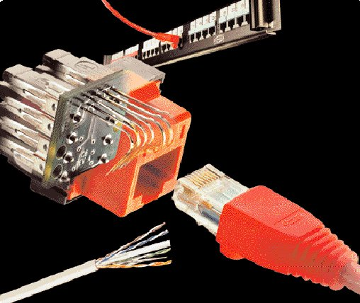
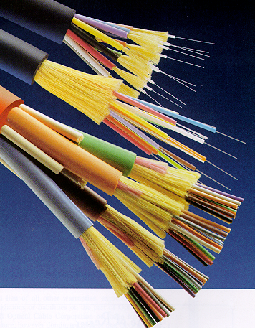
Physical Media
PHYSICAL MEDIA

Slide 5
Physical Media
Physical Media
Copper
  Coaxial Cable - Thick or Thin
  Unshielded Twisted Pair - CAT 3,4,5,5e&6
Optical Fiber
  Multimode
  Singlemode
Wireless
  Short Range
  Medium Range (Line of Sight)
  Satellite

Slide 6
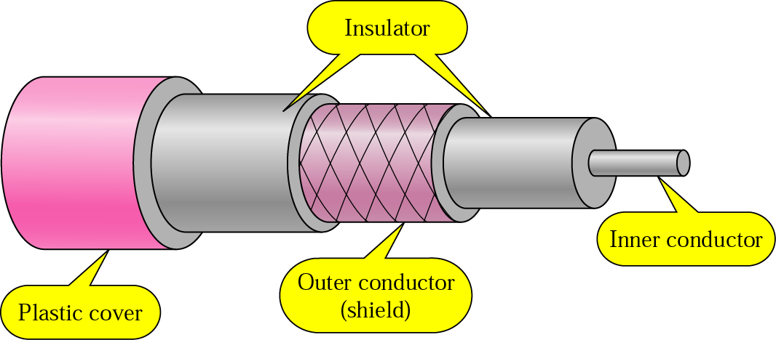
Copper Media: Coaxial Cable
Physical Media
Coaxial cable is a copper-cored cable surrounded by a heavy shielding and is used to connect computers in a network.
Outer conductor shields the inner conductor from picking up stray signal from the air.
High bandwidth but lossy channel.
Repeater is used to regenerate the weakened signals.
Category | Impedance | Use
RG-59 | 75 Ω | Cable TV
RG-58 | 50 Ω | Thin Ethernet
RG-11 | 50 Ω | Thick Ethernet

Slide 7
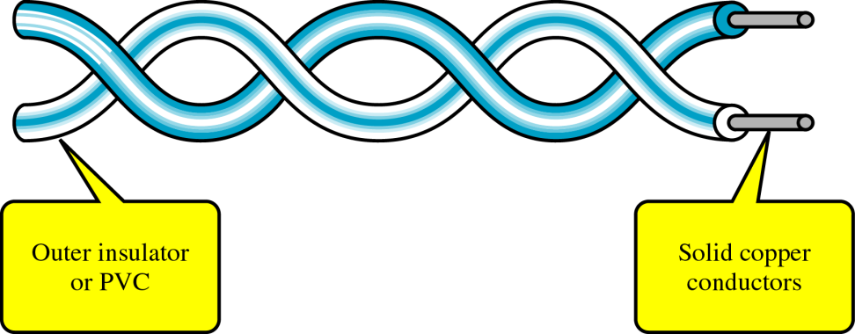
Copper Media: Twisted Pair
Physical Media
Twisted-pair is a type of cabling that is used for telephone communications and most modern Ethernet networks.
A pair of wires forms a circuit that can transmit data. The pairs are twisted to provide protection against crosstalk, the noise generated by adjacent pairs.
There are two basic types, shielded twisted-pair (STP) and unshielded twisted-pair (UTP).

Slide 8
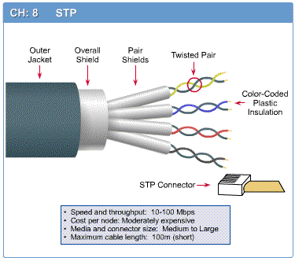
Shielded Twisted Pair (STP)
Physical Media

Slide 9
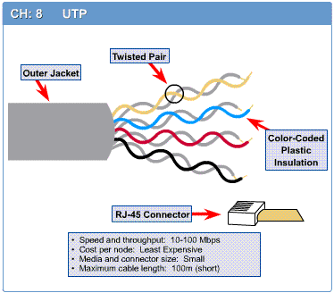
Unshielded Twisted Pair (UTP)
Physical Media

Slide 10
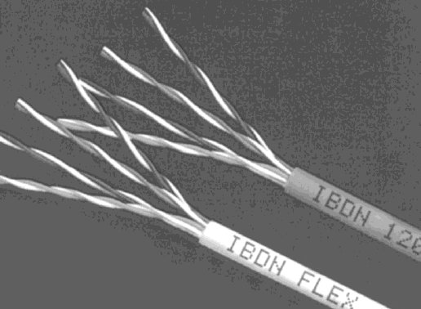
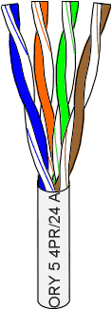
Unshielded Twisted Pair (UTP)
Physical Media
Consists of 4 pairs (8 wires) of insulated copper wires typically about 1 mm thick.
The wires are twisted together in a helical form.
Twisting reduces the interference between pairs of wires.
High bandwidth and High attenuation channel.
Flexible and cheap cable.
Category rating based on number of twists per inch and the material used
CAT 3, CAT 4, CAT 5, Enhanced CAT 5 and now CAT 6.

Slide 11
Categories of UTP
Physical Media
UTP comes in several categories that are based on the number of twists in the wires, the diameter of the wires and the material used in the wires.
Category 3 is the wiring used primarily for telephone connections.
Category 5e and Category 6 are currently the most common Ethernet cables used.

Slide 12
Categories of UTP: CAT 3
Physical Media
Bandwidth 16 Mhz
11.5 dB Attenuation
100 ohms Impedance
Used in voice applications and 10baseT (10Mbps) Ethernet

Slide 13
Categories of UTP: CAT 4
Physical Media
20 MHz Bandwidth
7.5 dB Attenuation
100 ohms Impedance
Used in 10baseT (10Mbps) Ethernet

Slide 14
Categories of UTP: CAT 5
Physical Media
100 MHz Bandwidth
24.0 dB Attenuation
100 ohms Impedance
Used for high-speed data transmission
Used in 10BaseT (10 Mbps) Ethernet & Fast Ethernet (100 Mbps)

Slide 15
Categories of UTP: CAT 5e
Physical Media
150 MHz Bandwidth
24.0 dB Attenuation
100 ohms Impedance
Transmits high-speed data
Used in Fast Ethernet (100 Mbps), Gigabit Ethernet (1000 Mbps) & 155 Mbps ATM

Slide 16
Categories of UTP: CAT 6
Physical Media
250 MHz Bandwidth
19.8 dB Attenuation
100 ohms Impedance
Transmits high-speed data
Used in Gigabit Ethernet (1000 Mbps) & 10 Gig Ethernet (10000 Mbps)

Slide 17

Fiber Media
Physical Media
Optical fibers use light to send information through the optical medium.
It uses the principal of total internal reflection.
Modulated light transmissions are used to transmit the signal.

Slide 18
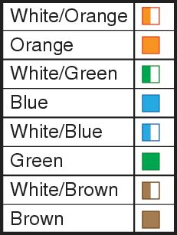
Cabling Standards
Physical Media
Cabling is an integral part of building any network.
When installing cable, it is important to follow cabling standards, which have been developed to ensure data networks operate to agreed levels of performance.
Cabling standards are a set of specifications for the installation and testing of cables.

Slide 19
Twisted Pair Cables
Physical Media
Twisted pair cable is most commonly used in network installations.
The TIA/EIA organization defines two different patterns, or wiring schemes, called T568A and T568B.
Each wiring scheme defines the pinout, or order of wire connections, on the end of the cable.
The two schemes are similar except two of the four pairs are reversed in the termination order.
TIA (Telecommunications Industry Association)
EIA (Electronics Industries Alliance).

Slide 20
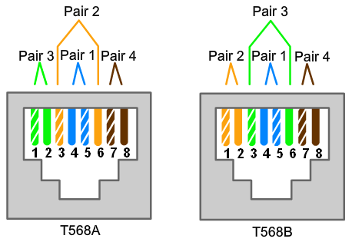
Twisted Pair Cables
Physical Media

Slide 21
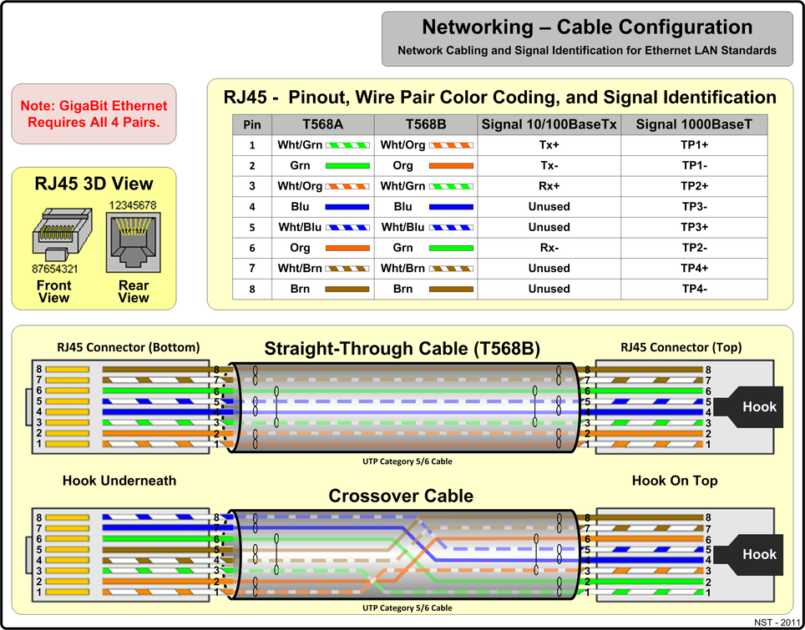
Twisted Pair Cables
Physical Media

Slide 22
Twisted Pair Cables
Physical Media
On a network installation, one of the two wiring schemes (T568A or T568B) should be chosen and followed.

Slide 23
Twisted Pair Cables
Physical Media
Using the T568A and T568B wiring schemes, two types of cables can be created:
  a straight-through cable
  a crossover cable.
These two types of cable are found in data installations.

Slide 24
Straight-through Cable
Physical Media
A Straight-through cable is the most common cable type.
It maps a wire to the same pins on both ends of the cable.
  If T568A is on one end of the cable, T568A is also on the other.
  If T568B is on one end of the cable, T568B is on the other. This means that the order of connections (the pinout) for each color is the exact same on both ends.

Slide 25
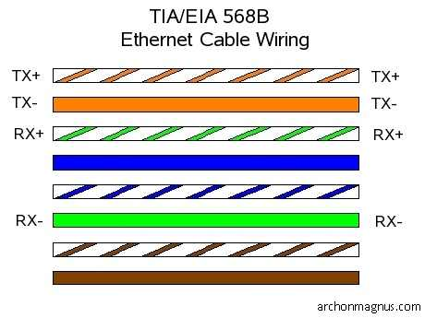
Straight-through Cable
Physical Media

Slide 26
Crossover Cable
Physical Media
A crossover cable uses both wiring schemes.
T568A on one end of the cable and T568B on the other end of the same cable. This means that the order of connection on one end of the cable does not match the order of connections on the other.
The straight-through and crossover cables each have a specific use on the network. The type of cable needed to connect two devices depends on which wire pairs the devices use to transmit and receive data.

Slide 27
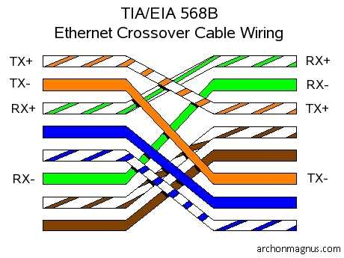
Crossover Cable
Physical Media

Slide 28
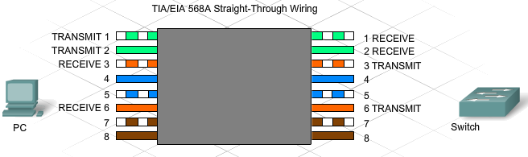
Working with Twisted-Pair Cabling
Physical Media
Specific pins on the connector are associated with a transmit function and a receive function. The transmit pin versus the receive pin is determined by the device being used.

Slide 29
Unlike and Like Devices
Physical Media
Two devices directly connected and using different pins for transmit and receive are known as unlike devices. They require a straight-through cable to exchange data.
Devices that are directly connected and use the same pins for transmit and receive, are known as like devices. They require the use of a crossover cable to exchange data.

Slide 30
Unlike and Like Devices
Physical Media
Examples of unlike devices that require a straight-through cable include:
  Switch port to router port
  Hub port to PC

Slide 31
Physical Media
Unlike and Like Devices
If a PC is directly connected to another PC (like devices), pins 1 and 2 on both devices are transmit pins and pins 3 and 6 are receive pins.
A crossover cable would ensure that the green wire connected to pins 1 and 2 (transmit pins) on one PC connect to pins 3 and 6 (receive pins) on the other PC.
If a straight-through cable were used, the wire connected to pin 1, the transmit pin, on PC1 would be connected to pin 1, the transmit pin, on PC2. It is not possible to receive data on a transmit pin.

Slide 32
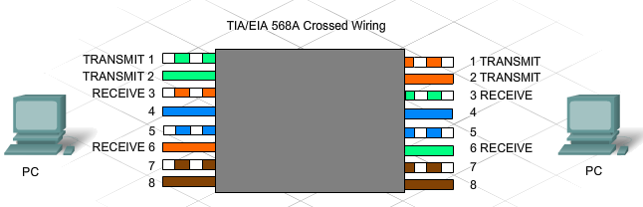
Unlike and Like Devices
Physical Media

Slide 33
Unlike and Like Devices
Physical Media
Other examples of like devices that require a crossover cable include:
  Switch port to switch port
  Switch port to hub port
  Hub port to hub port
  Router port to router port
  PC to PC
If the incorrect cable type is used, the connection between network devices will not function.
Some devices can automatically sense which pins are used for transmit and receive and will adjust their internal connections accordingly.

Slide 34
Rollover Cable
Physical Media
Rollover cable (also known as Cisco console cable) is a type of null-modem cable that is most commonly used to connect a computer terminal to a router's console port.
  Cisco routers and switches are normally configured over their console ports.
This cable is typically flat and the colour is also different to help distinguish it from other types of network cabling.
It gets the name rollover because the pinouts on one end are reversed from the other, as if the wire had been rolled over and you were viewing it from the other side.

Slide 35
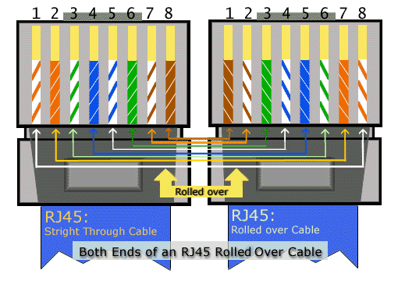
Rollover Cable
Physical Media

Slide 36
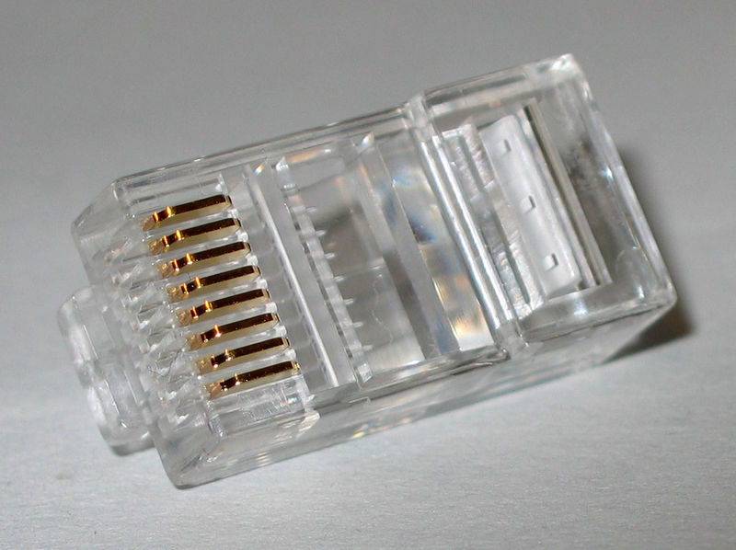
RJ45 connector
Physical Media

Slide 37
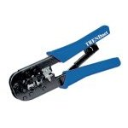
Making connections - Tools
Physical Media
Cat5e cable
RJ45 connectors
Cable stripper
Scissors
Crimping tool

Slide 38
Making connections - Steps
Physical Media
Strip cable end
Untwist wire ends
Arrange wires
Trim wires to size
Attach connector
Check
Crimp
Test

Slide 39
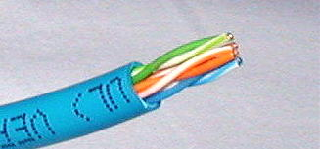
Step 1 – Strip cable end
Physical Media
Strip 1 – 1½” of insulating sheath
Avoid cutting into conductor insulation

Slide 40
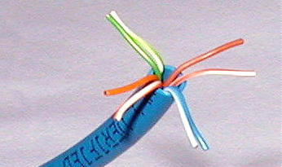
Step 2 – Untwist wire ends
Physical Media
Sort wires by insulation colors

Slide 41
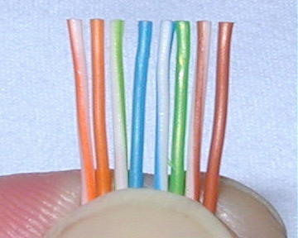
Step 3 – Arrange wires
Physical Media
TIA/EIA 568A: GW-G OW-Bl BlW-O BrW-Br
TIA/EIA 568B: OW-O GW-Bl BlW-G BrW-Br

Slide 42
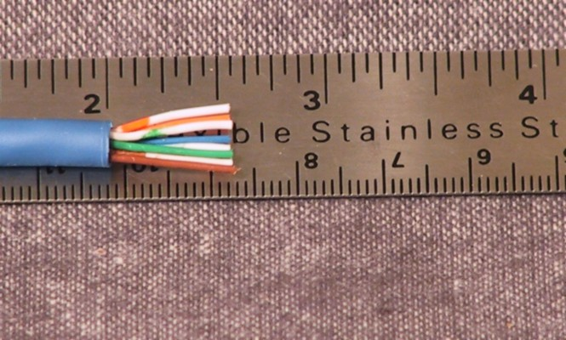
Step 4 – Trim wires to size
Physical Media
Trim all wires evenly
Leave about ½” of wires exposed

Slide 43
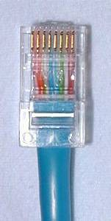
Step 5 – Attach connector
Physical Media
Maintain wire order, left-to-right, with RJ45 tab facing downward

Slide 44
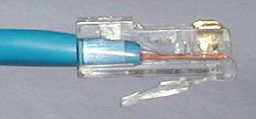
Step 6 - Check
Physical Media
Do all wires extend to end?
Is sheath well inside connector?

Slide 45
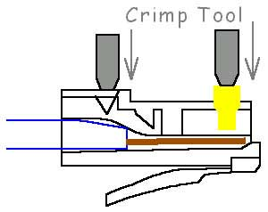
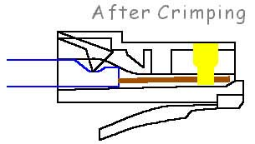
Step 7 - Crimp
Physical Media
Squeeze firmly to crimp connecter
onto cable end (8P)

Slide 46
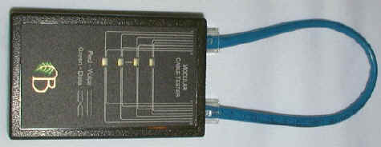
Step 8 – Test
Physical Media
Does the cable work?

Slide 47
Marks
Physical Media
10/10 = a successful cable that is prepped, crimped, and connects properly.
05/10 = a cable that does not work but is set-up reasonably well and has a detailed response as to possible solutions or reasons as to why the cable does not work.
0/10 = cable does not work and no explanation as to why.

Slide 48
LET’S GET STARTED!!

Slide 49
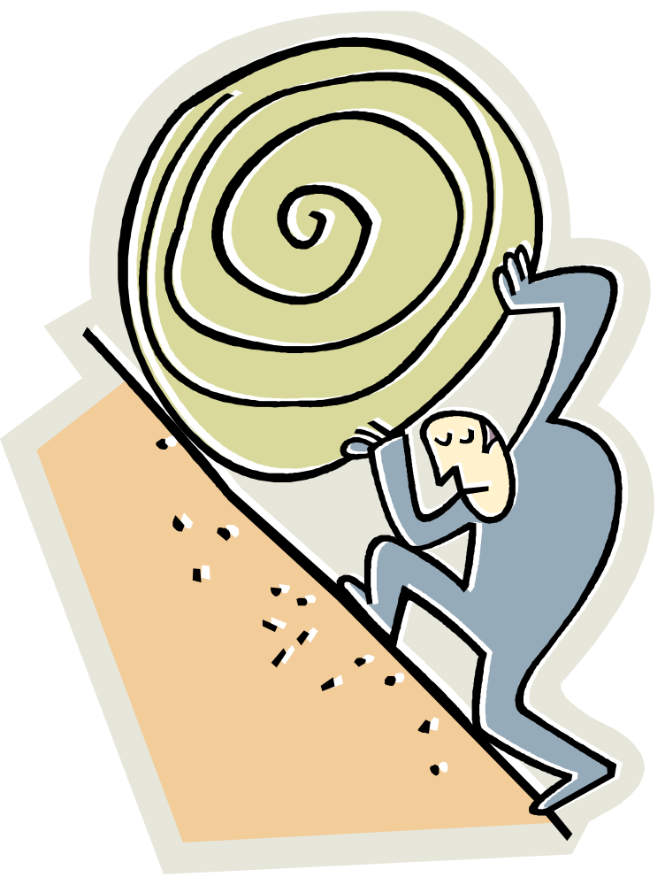
LET’S GO TO WORK!

